Slide 1
Satellite: 1
Orbit Period: 120/148 min
Solar Array: 80 m^2 (40%)
Vehicle Pwr Draw: 200 W (50%)
Laser Pwr::4 kW (20%)
(1) (2) (3) (4)
Battery: 45%: 4/5 kWhr
|||||||||
Customer: 1 (85,45)
Beam Range: 938 km
Beam Diameter: 1.8 m
Beam Power: 2.3 W/m^2
Power Draw: 0.1 kW (50%)
Battery: 45% (4/5 kWhr)
|||||||||
Customer: 2
Lat, Long: 85, 45
Solar Array Size: 1 m^2
EPS Efficiency: 50%
Power Draw: : 80 W
Battery: 4.0/5.0 kWhr
|||||||||45%
Shadow half circle rotates about the south pole
4
90
Customer: 3
Lat, Long: 85, 45
Solar Array Size: 1 m^2
EPS Efficiency: 50%
Battery Capacity: 5.0 kWhr
Battery Charge: 4.0 kWhr
|||||||||45%
Customer: 4
Lat, Long: 85, 45
Solar Array Size: 80 m^2
EPS Efficiency: 50%
Battery Capacity: 5.0 kWhr
Battery Charge: 4.0 kWhr
|||||||||45%
Satellite: 2
Orbit Period: 120/148 min
Solar Array Size: 80 m^2 (40%)
Vehicle Pwr Draw: 200 W (50%)
Battery: 45%: 4/5 kWhr
|||||||||
Laser Pwr::4 kW (20%)
(1) (2) (3) (4)
1
3
1
5
Customer: 5
Lat, Long: 85, 45
Solar Array Size: 1 m^2
EPS Efficiency: 50%
Battery Capacity: 5.0 kWhr
Battery Charge: 4.0 kWhr
|||||||||45%
Customer: 6
Lat, Long: 85, 45
Solar Array Size: 1 m^2
EPS Efficiency: 50%
Battery Capacity: 5.0 kWhr
Battery Charge: 4.0 kWhr
|||||||||45%
6
0
Satellite: 3
Orbit Period: 120/148 min
Solar Array Size: 80 m^2
EPS Efficiency: 50%
Battery Capacity: 5.0 kWhr
Battery Charge: 4.0 kWhr
|||||||||45%
Laser Eff: 20% (1 2 3 4)
180
4
8
2
7
Customer: 7
Lat, Long: 85, 45
Solar Array Size: 1 m^2
EPS Efficiency: 50%
Battery Capacity: 5.0 kWhr
Battery Charge: 4.0 kWhr
|||||||||45%
Customer: 8
Lat, Long: 85, 45
Solar Array Size: 1 m^2
EPS Efficiency: 50%
Battery Capacity: 5.0 kWhr
Battery Charge: 4.0 kWhr
|||||||||45%
2
Satellite: 4
Orbit Period: 120/148 min
Solar Array Size: 80 m^2
EPS Efficiency: 50%
Battery Capacity: 5.0 kWhr
Battery Charge: 4.0 kWhr
|||||||||45%
Laser Eff: 20% (1 2 3 4)
270
3
Orbit ellipse (expand contact time for graphic)::
Contact time: 120 deg (21 min: 20 deg – 160 deg)
Non-contact: time: 240 deg (127 min: 160 deg – 20 deg)
Visibility (layering) Search time 2 min dashed line

Slide 2
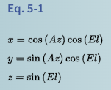
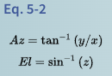
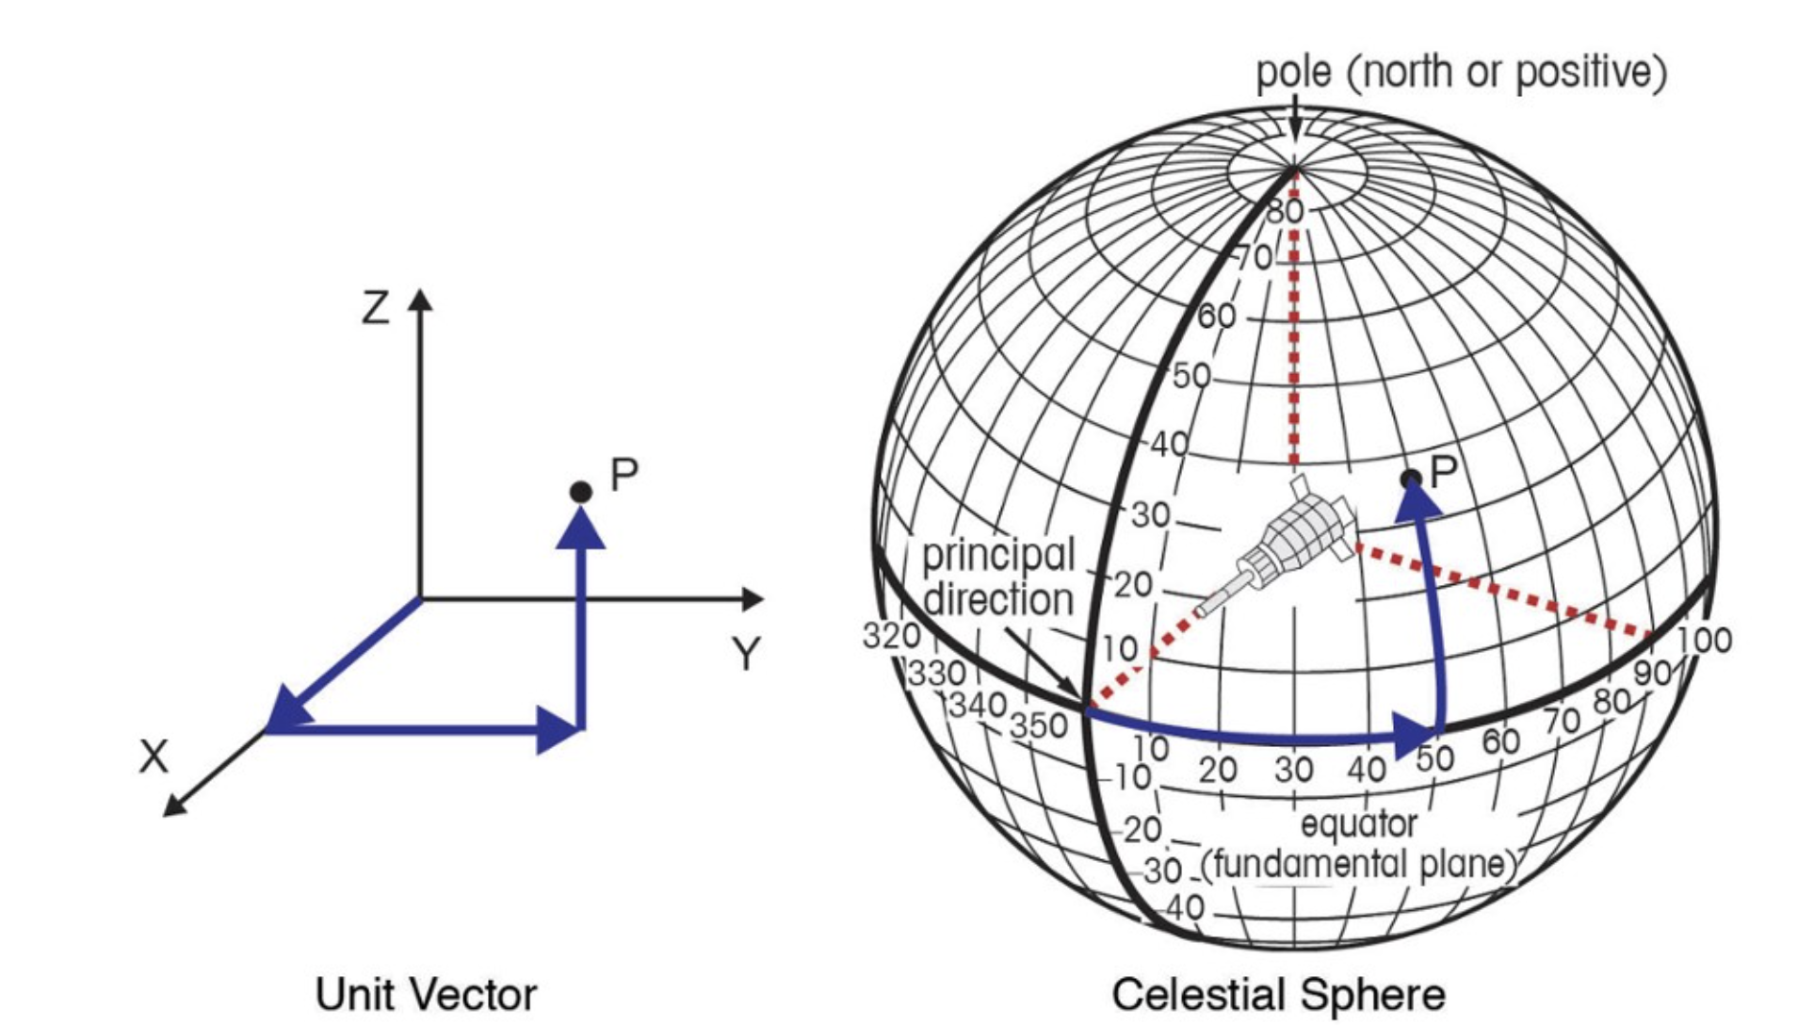
https://stackoverflow.com/questions/1185408/converting-from-longitude-latitude-to-cartesian-coordinates
SMAD section 5-1 Eq 5-1
the x-axis goes through long,lat (0,0), so longitude 0 meets the equator;
the y-axis goes through (0,90);
and the z-axis goes through the poles.
x = R * cos(lat) * cos(lon)
y = R * cos(lat) * sin(lon)
z = R *sin(lat)
Use unit vectors
Az= atan(y/x)
El=asin(z/range)

Slide 3
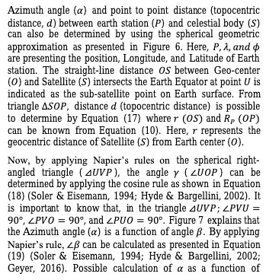
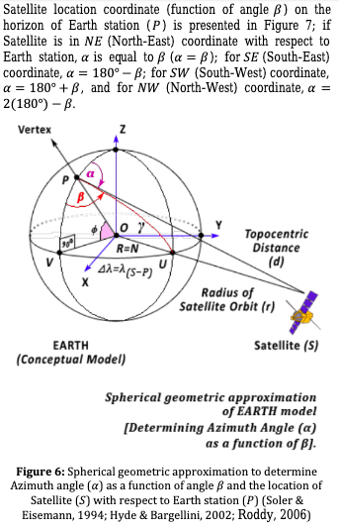
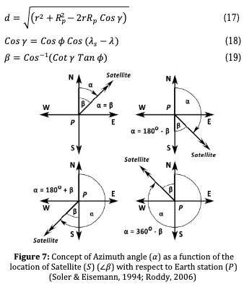

Slide 4
Mission Concepts
Determine minimum power delivery to provide value
250 W/day = 10W continuous for 24 hrs + 10W/day margin (small)
1000 W/day = 40W conintuous for 24 hrs + 40W/day margin (med)
2000 W/day = 80W continuous for 24 hrs + 80W/day margin (large)
Determine the number of lasers (1,2,4 1kW lasers)
number of customers
power of each beam
Optimize the number of satellites
revisit time
system complexity
launch cost
redunancy
Optimize the satellite architecture to drive the lasers
solar panel size

Slide 5
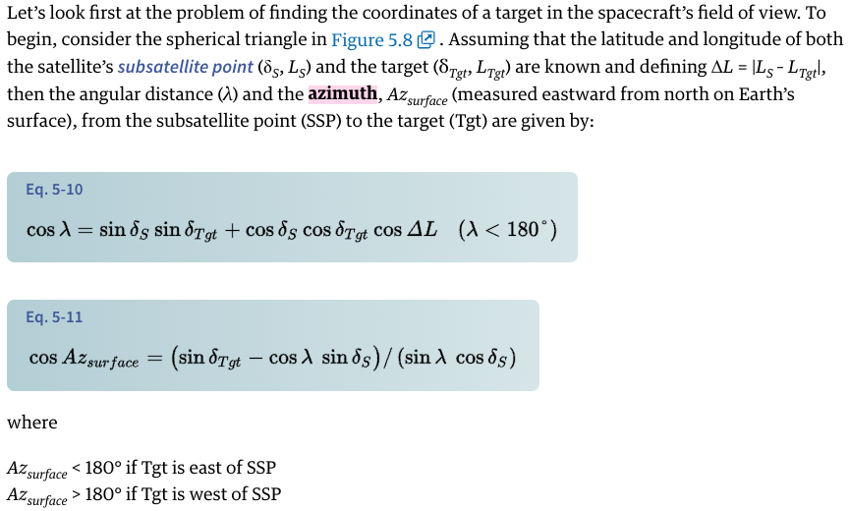
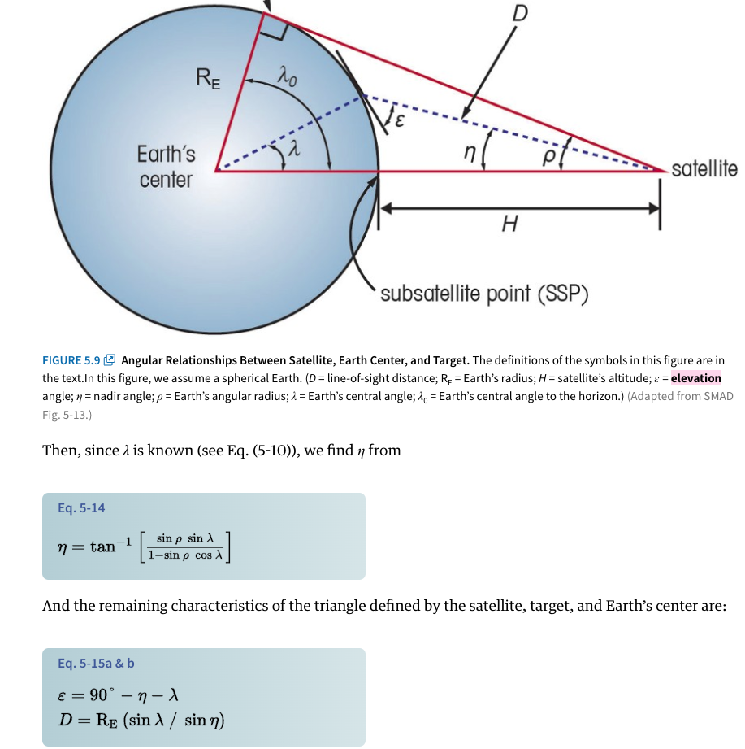
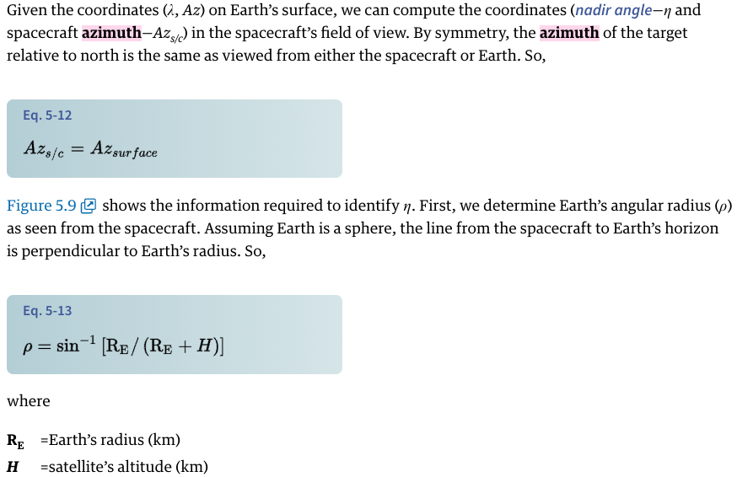
SMAD 5.2

Slide 6
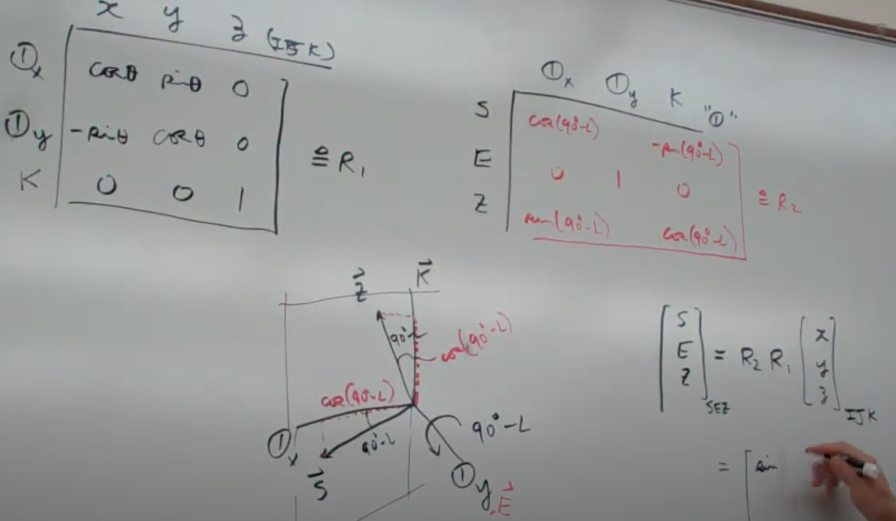

Slide 7
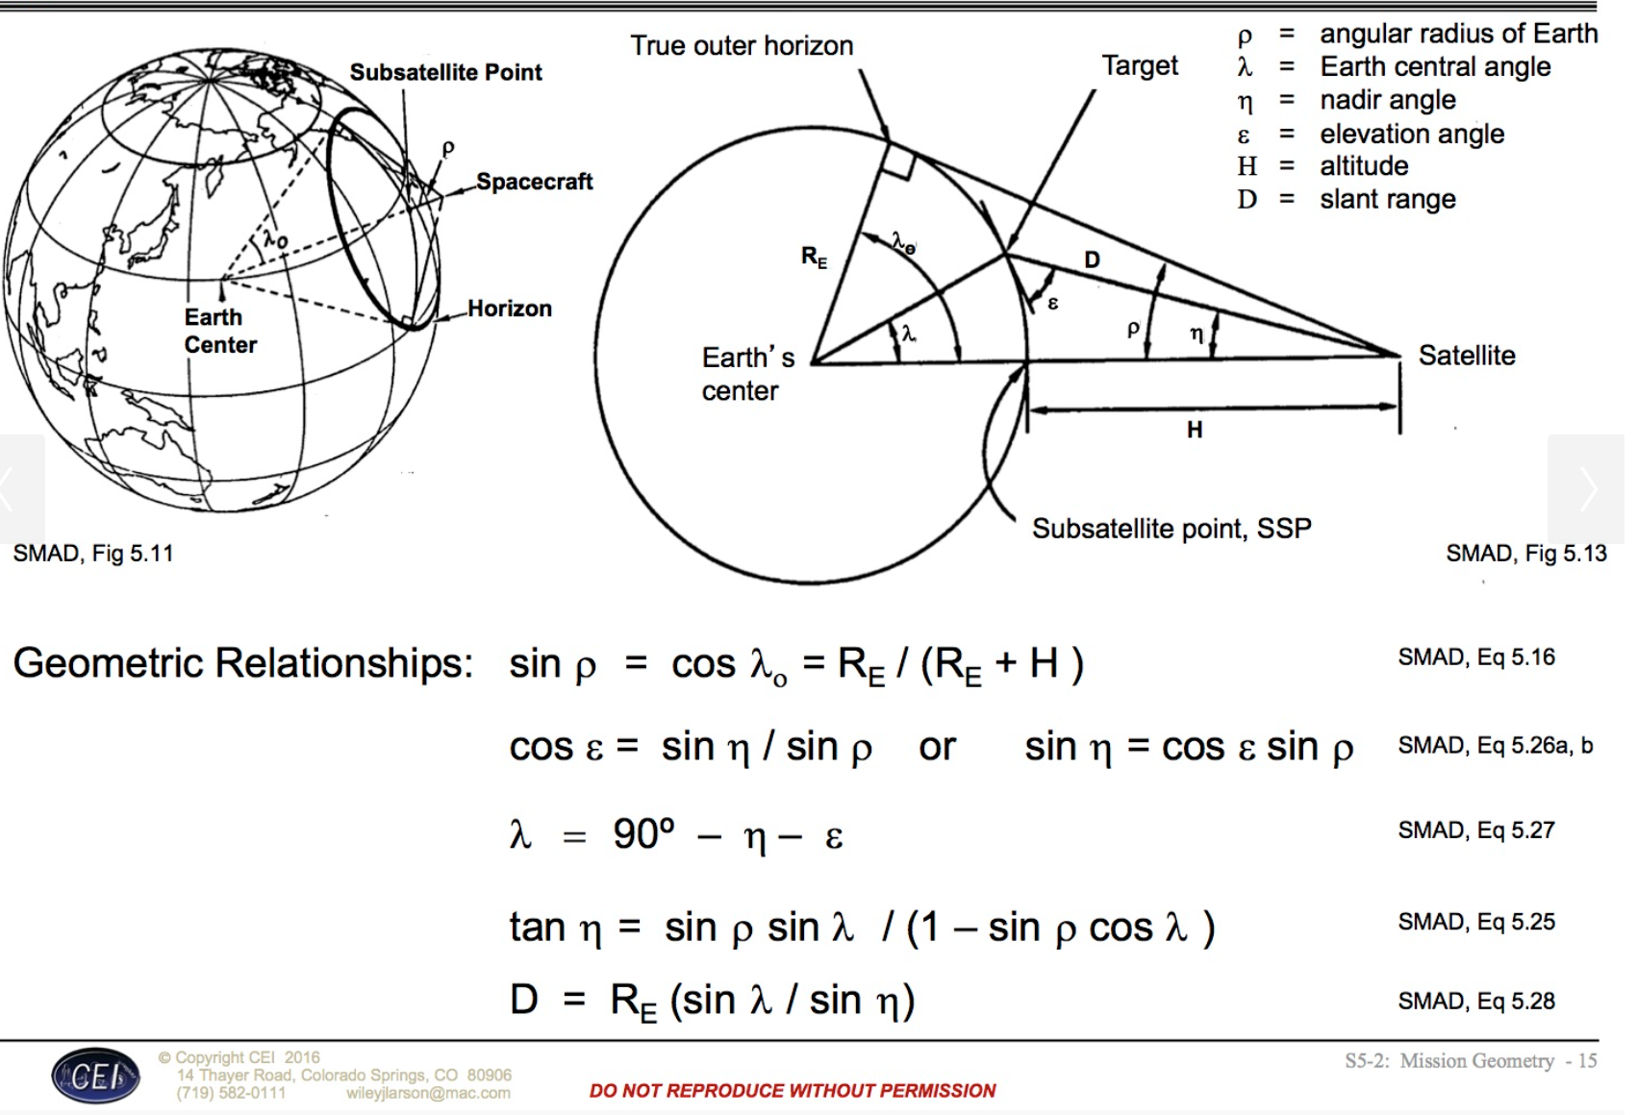

Slide 8
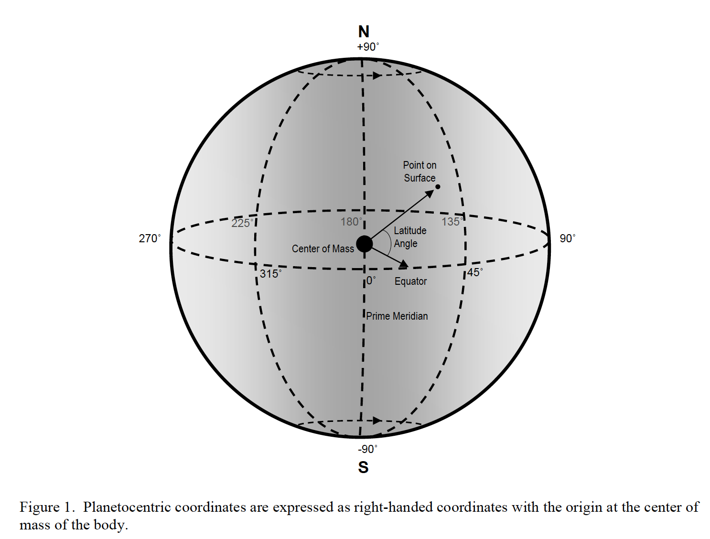
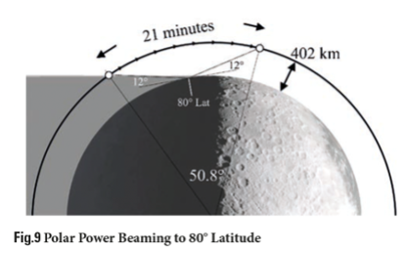

Slide 9
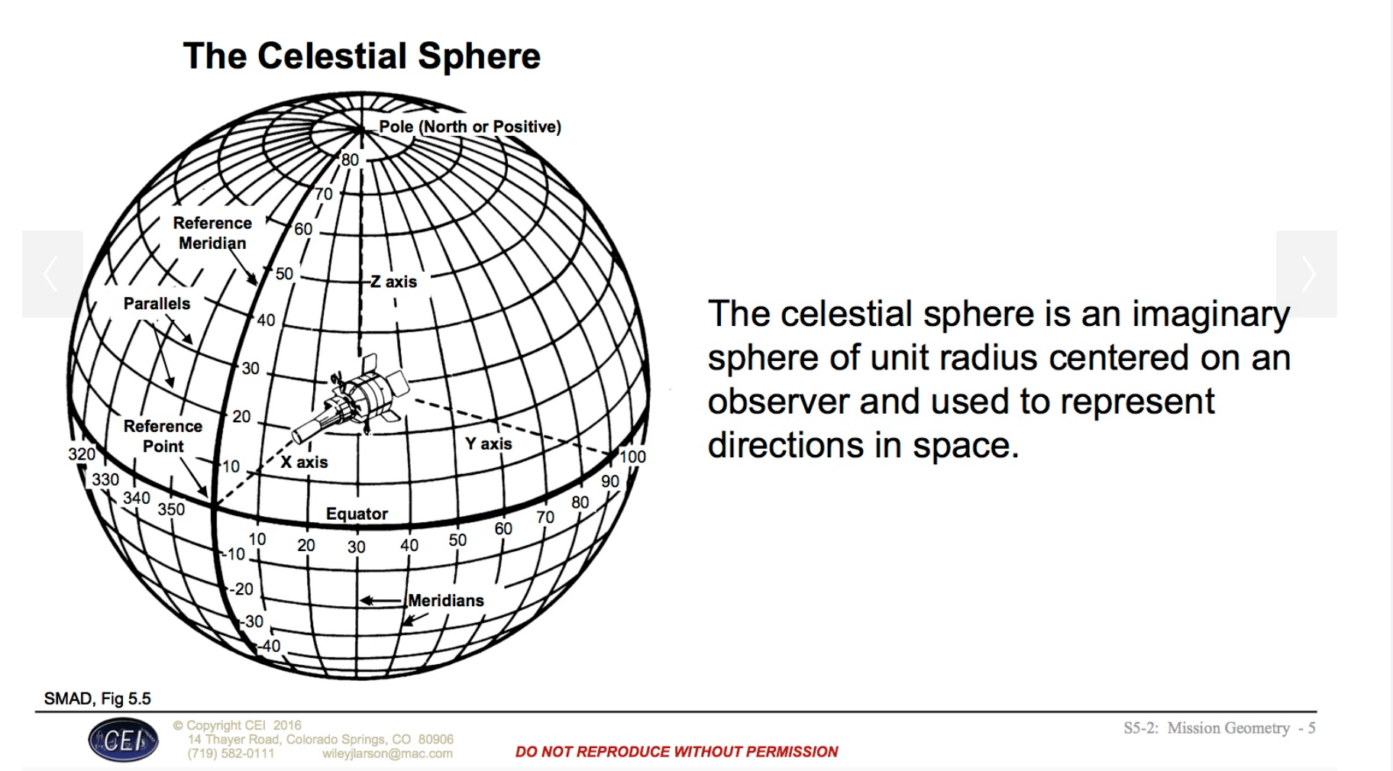

Slide 10
